Slide 1
Optimization Methods and Software for Federated Learning PhD Defense Konstantin Burlachenko Computer Science, KAUST

Slide 2
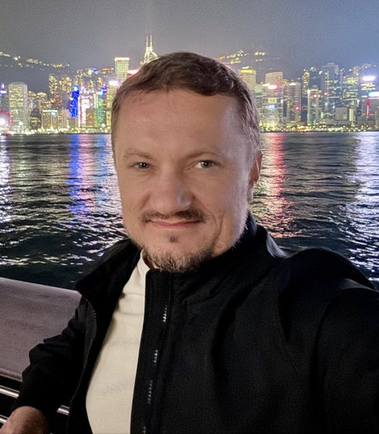
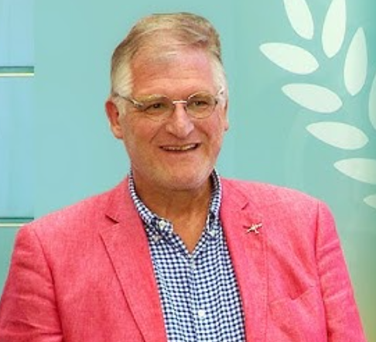

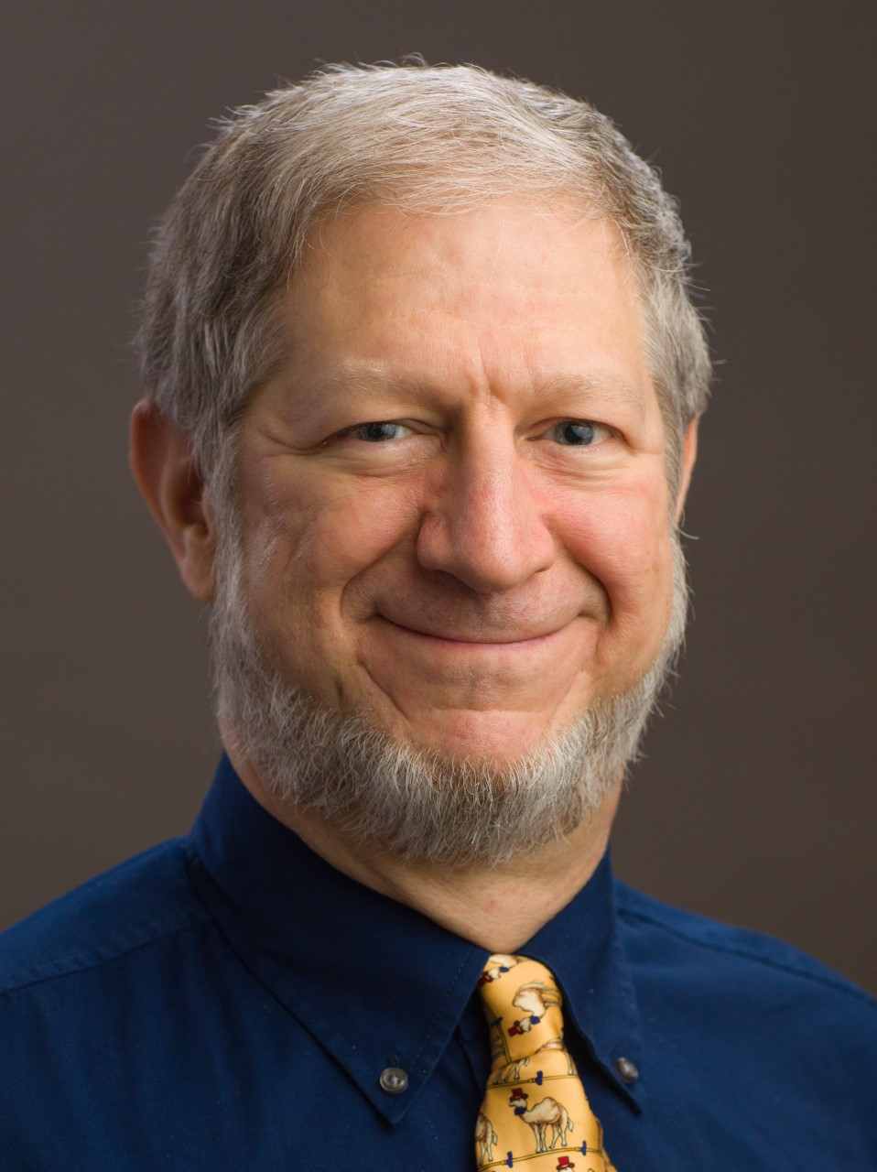
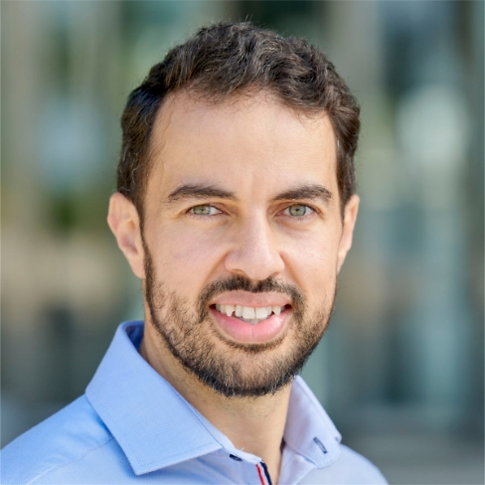
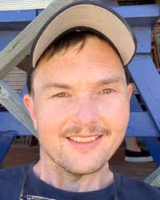
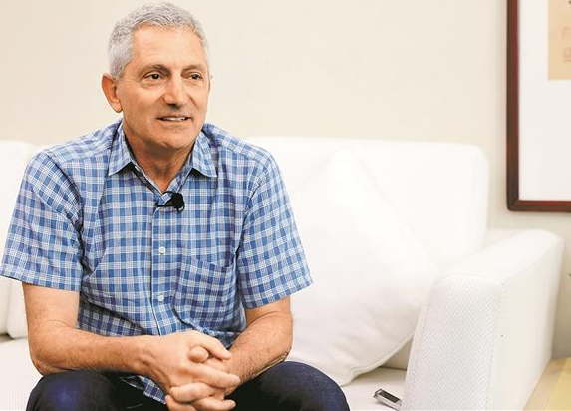


#1
Dissertation Defense Committee Members
Peter Richtárik Eric Feron
David Keyes Suhaib Fahmy
Stephen Boyd Nic Lane
Images: Google Search

Slide 3
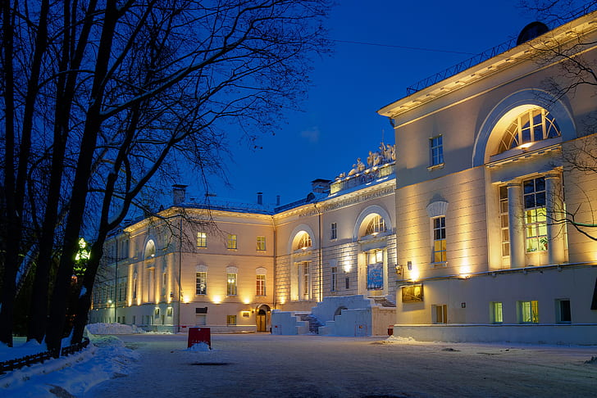

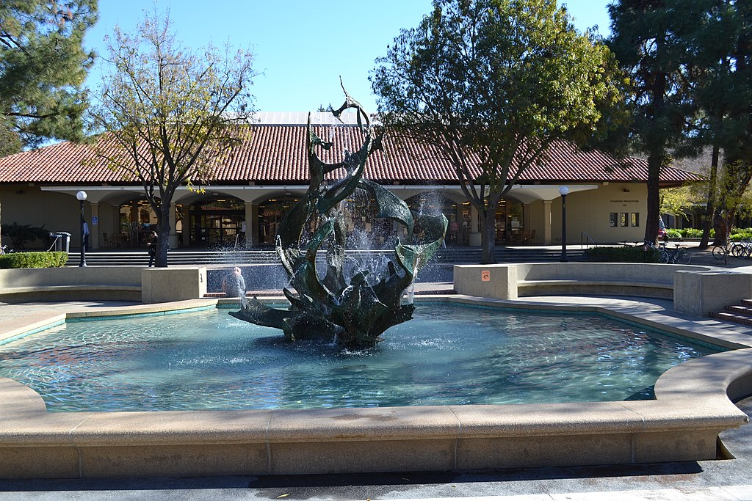
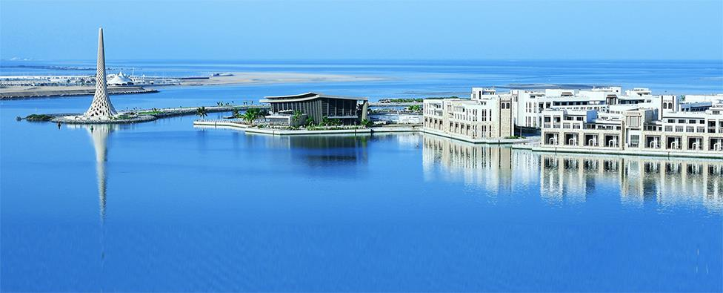
#2
#1
Background
MS in Computer Science
Bauman Moscow State Technical University (2003 — 2009)
Industry Experience
Startup (2012) Acronis (2010 — 2012) Yandex (2013 — 2014)
NVIDIA (2014 — 2019) HUAWEI (2019 — 2020)
Stanford Graduate Certificates
Data, Models and Optimization Graduate Certificate (2015 — 2018)
Artificial Intelligence Graduate Certificate (2016 — 2019)
PhD Academic Journey
Joined Prof. P. Richtárik’s Optimization and ML Lab at KAUST (August 2020)
Defended CS PhD Proposal (2022)
Member of Center of Excellence SDAIA-KAUST AI (2022 — 2023)
Internships
Research Scientist Internship Offer, Facebook Inc., Menlo Park, USA (2021)
Internship in Private Federated Learning ML Team, Apple, Cambridge, UK (2024)
Conference Presentations
Presentations: ICLR’24, SIAM’23, ICML’21, NSF-TRIPODS’21, DistributedML’21&’23
Awards
Dean’s Award (2020) Grant from SDAIA (2022) Dean’s Award (2023)
AMD MI50 from AMD (2023) Shaheen III Proposal (2024) RDIA grant (2025)
Images: Google Search
Notes:
- Maybe split into 2 sdlides

Slide 4









#3
Papers Co-Authored During PhD (Creation Timeline)
[1] | Personalized Federated Learning with Communication Compression E. Bergou, K. Burlachenko, A. Dutta, P. Richtárik
[2] | MARINA: Faster Non-Convex Distributed Learning with Compression E. Gorbunov, K. Burlachenko, Z. Li, P. Richtárik
[3] | Fl_PyTorch: Optimization Research Simulator for Federated Learning K. Burlachenko, S. Horváth, P. Richtárik
[4] | Faster Rates for Compressed Federated Learning with Client-Variance Reduction H. Zhao, K. Burlachenko, Z. Li, P. Richtárik
[5] | Don’t Compress Gradients in Random Reshuffling: Compress Gradient Differences A. Sadiev, G. Malinovsky, E. Gorbunov, I. Sokolov, A. Khaled, K. Burlachenko, P. Richtárik
[6] | Sharper Rates and Flexible Framework for Nonconvex SGD with Client and Data Sampling A. Tyurin, L. Sun, K. Burlachenko, P. Richtárik
[7] | Federated Learning with Regularized Client Participation G. Malinovsky, S. Horváth, K. Burlachenko, P. Richtárik
[8] | Error Feedback Shines when Features are Rare P. Richtárik, E. Gasanov, K. Burlachenko
[9] | Federated Learning is Better with Non-Homomorphic Encryption K. Burlachenko, A. Alrowithi, F. Ali Albalawi, P. Richtárik
[10] | Error Feedback Reloaded: From Quadratic to Arithmetic Mean of Smoothness Constants P. Richtárik, E. Gasanov, K. Burlachenko
[11] | Unlocking FedNL: Self-Contained Compute-Optimized Implementation K. Burlachenko, P. Richtárik
[12] | PV-Tuning: Beyond Straight-Through Estimation for Extreme LLM Compression V. Malinovskii, D. Mazur, I. Ilin, D. Kuznedelev, K. Burlachenko, K. Yi, D. Alistarh, P. Richtárik
[13] | BurTorch: Revisiting Training from First Principles by Coupling Autodiff, Math Optimization, and Systems K. Burlachenko, P. Richtárik
Ch6
Symposium on
ACM PODC 2022
Ch2
Symposium on
SIAM OP23
Workshop
FL-ICML-2023
Ch5
Workshop
FL-ICML-2023
Preparing for
Resubmission
Ch4
Ch3
ML Summer School
Okinawa 2024
Ch7
KAUST AI Symposium 2024
Ch8
Notes:
Do not say “plenty”.
+ capitalization
+ numbers
+ remove proceedings
+ make as clean as possible

Slide 5
Machine Learning
#4
Traditional machine learning assumes that
the training dataset is collected and stored centrally
Notes:
|\mathbb{E}_{(x,y) \sim D}[F(x;w_{\rm erm}) \ne y] - \mathbb{E}_{(x,y) \sim D}[F(x;w_{\rm rm}) \ne y] | \le \mathcal{O} \left( \sqrt{\frac{VC(F)}{M}log(M/VC(F)) + \frac{1}{n}log(1/\delta)} \right)
- Certain minimal size
- Replace \omega => “w”
45 minutes
Maximum contributions
Replace

Slide 6
Machine Learning
#4
Traditional machine learning assumes that
the training dataset is collected and stored centrally
However, centralized storage is not where data is generated in the first place

Slide 7

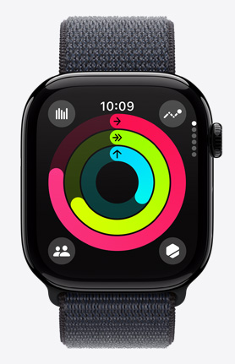
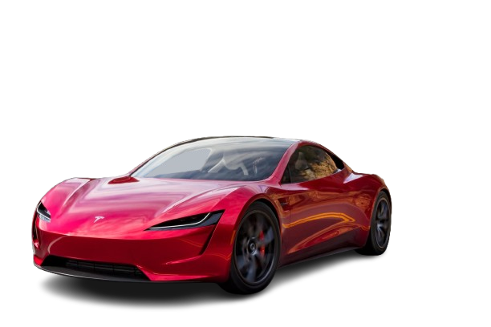
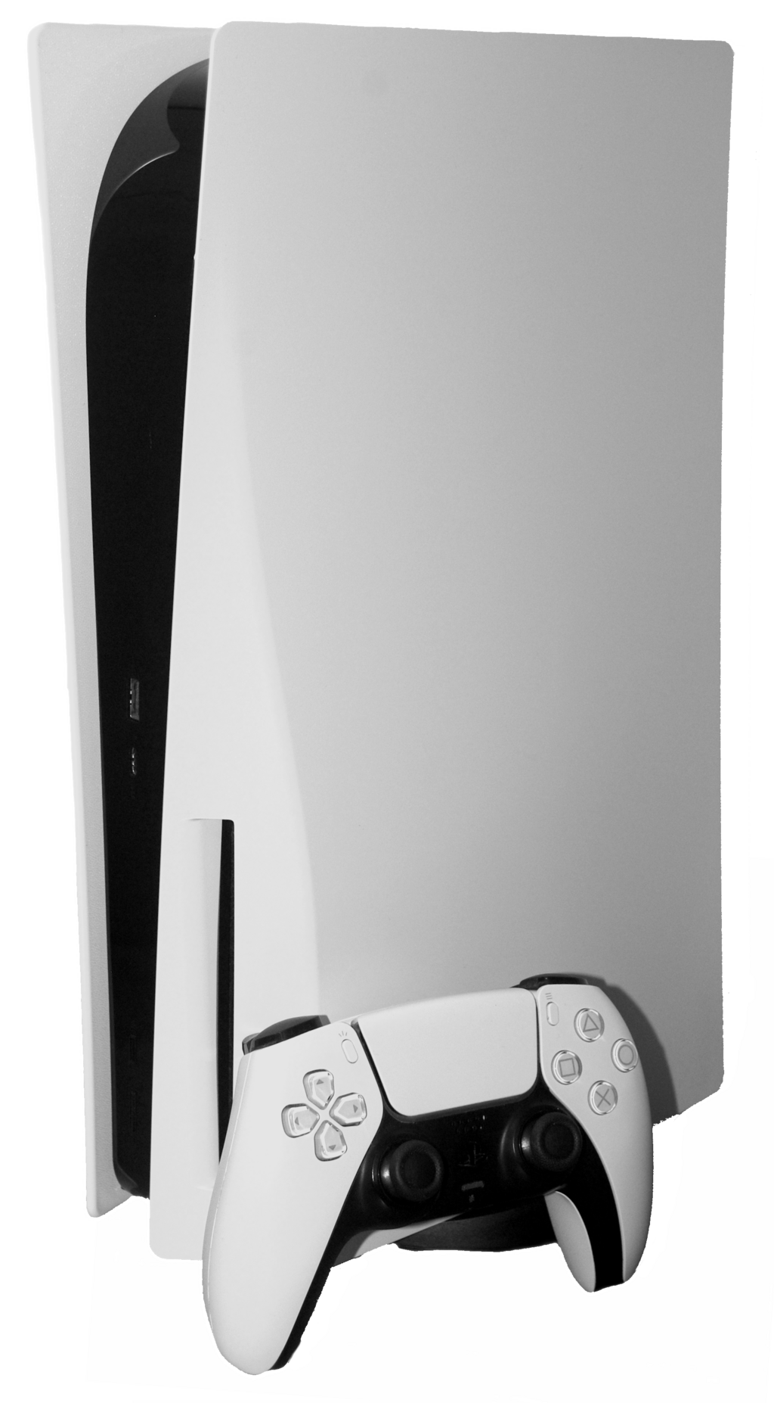
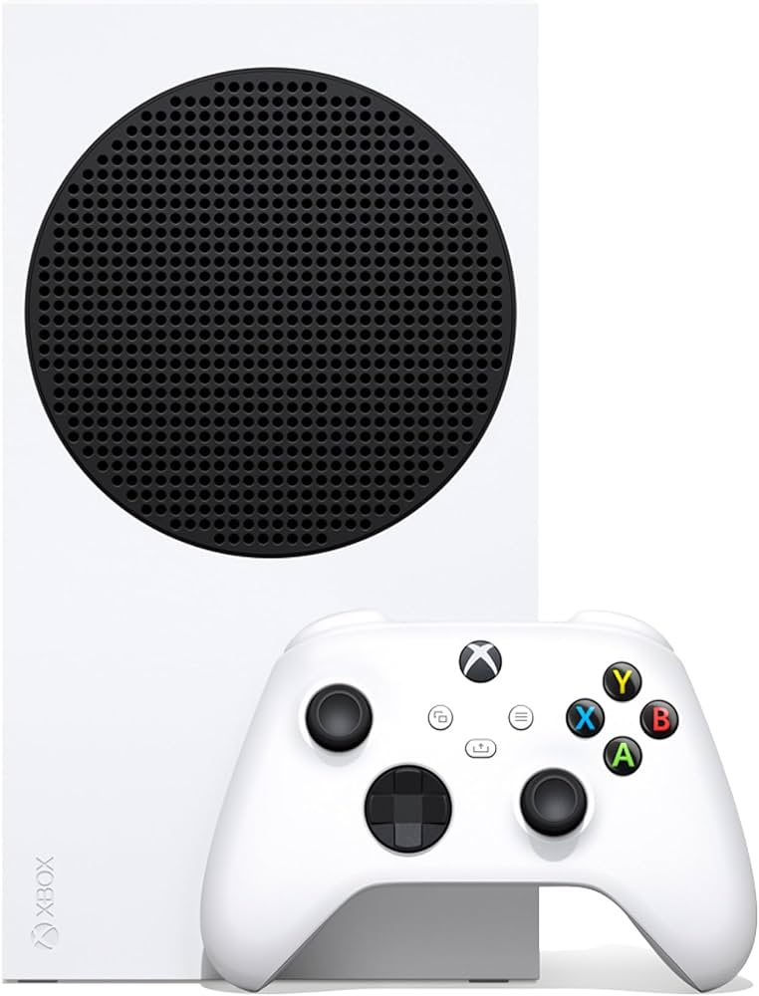


#5
#4
Shifting Training to Edge Devices
Fast Ethernet | 12 MBytes/sec
Gigabit Ethernet | 125 MBytes/sec
InfiniBand HDR | 6250 Mbytes/sec
InfiniBand Melanox | 25000 Mbytes/sec
Abstract Edge Device
watchOS
(iOS based)
macOS, Windows,
Linux, Unix
Android
iOS
Tesla: Tesla OS
BMW, Volvo: QNX
Orbis
(Unix-like)
Xbox System Software
(Windows-like)
Images: Google Search

Slide 8

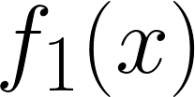
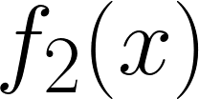
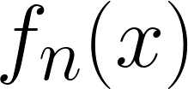
#6
#4
#4
Shifting Training to Edge Devices
. . .

Slide 9
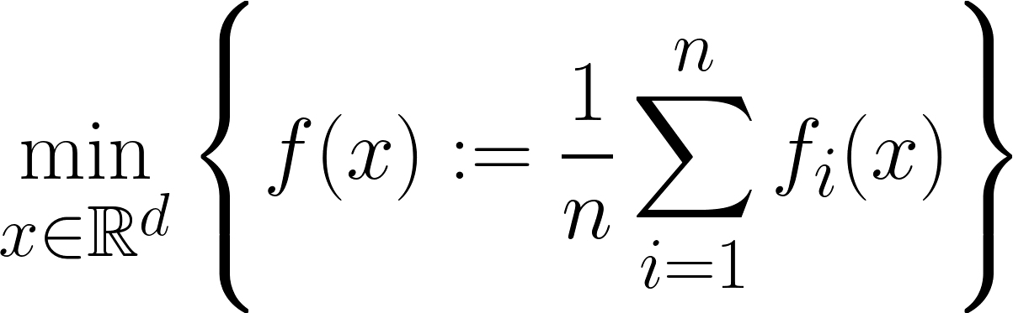

#6
Shifting Training to Edge Devices
Optimization objective
. . .
The success of applying supervised ML (for fixed <X,Z,Y>) depends on:
1. Sample Size, Signal-to-Noise ratio.
2. Your assumptions about $ℱ$.
3. If use y = $\hat{F}$(x) as a predictor success depend on Z in (X, Y).

Slide 10
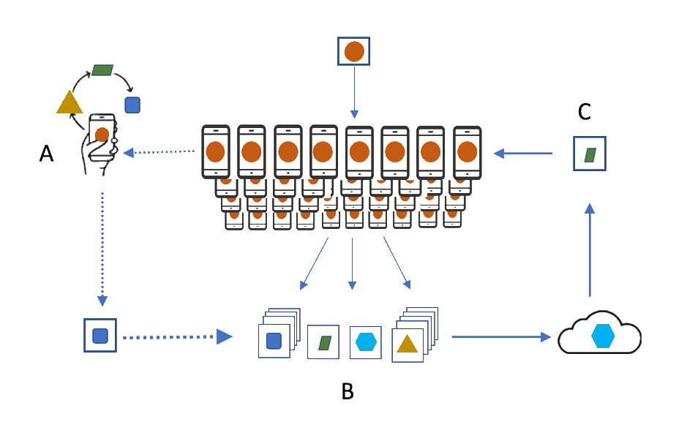
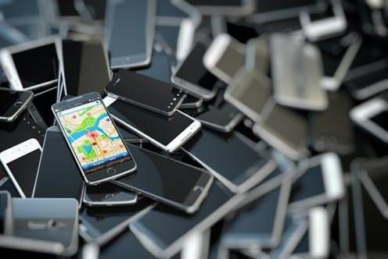
Federated Learning (FL)
#7
Images: Google Search
FL Origins
Federated Learning: Strategies for Improving Communication Efficiency (2016) J. Konečný, B. McMahan, F. X. Yu, P. Richtárik, A.T. Suresh, D. Bacon
Federated Optimization: Distributed Machine Learning for On-Device Intelligence (2016) J.Konečný, B. McMahan, D. Ramage, P. Richtárik
Communication-Efficient Learning of Deep Networks from Decentralized Data (2017) B.McMahan, et al.
Advances and Open Problems in Federated Learning (2021) P. Kairouz, et al.
The first publication with “Federated Learning” in its title
While FL mitigates sample size limitations and enables novel decentralized applications, it also brings new challenges

Slide 11
Federated Learning Challenges Addressed in the Thesis
#8
Theoretical Work
Theory-Inspired Practical Work
Practical Work
1. Data Heterogeneity
2. Device Heterogeneity
3. Communication
Bottleneck
4. Privacy
5. Software
Ch1: Introduction
Ch2: FL_PyTorch
Burlachenko et al., 2021
Ch3: EF21-W
Richtárik et al., 2024
Ch3: EF21-W
Richtárik et al., 2024
Ch4: DCGD/PERMK/AES
Burlachenko et al., 2023
Ch5: PAGE Extensions
Tyurin et al., 2023
Ch6:
Compressed L2GD
Bergou et al., 2023
Ch6:
Compressed L2GD
Bergou et al., 2023
Ch7: Unlocking FedNL
Burlachenko and Richtárik, 2024
Ch7: Unlocking FedNL
Burlachenko & Richtárik, 2024
Ch8: BurTorch
Burlachenko & Richtárik, 2025
Ch8: BurTorch
Burlachenko & Richtárik, 2025
Ch9: Concluding Remarks: Summary and Future Research

Slide 12
Federated Learning Challenges Addressed in the Thesis
#9
Theoretical Work
Theory-Inspired Practical Work
Practical Work
1. Data Heterogeneity
2. Device Heterogeneity
3. Communication
Bottleneck
4. Privacy
5. Software
Ch1: Introduction
Ch2: FL_PyTorch
Burlachenko et al., 2021
Ch3: EF21-W
Richtárik et al., 2024
Ch3: EF21-W
Richtárik et al., 2024
Ch4: DCGD/PERMK/AES
Burlachenko et al., 2023
Ch5: PAGE Extensions
Tyurin et al., 2023
Ch6:
Compressed L2GD
Bergou et al., 2023
Ch6:
Compressed L2GD
Bergou et al., 2023
Ch7: Unlocking FedNL
Burlachenko and Richtárik, 2024
Ch7: Unlocking FedNL
Burlachenko & Richtárik, 2024
Ch8: BurTorch
Burlachenko & Richtárik, 2025
Ch8: BurTorch
Burlachenko & Richtárik, 2025
Ch9: Concluding Remarks: Summary and Future Research

Slide 13
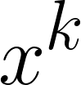
Distributed Gradient Descent
#10

Slide 14
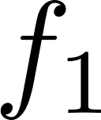
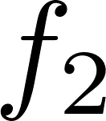
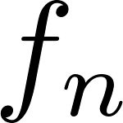
Distributed Gradient Descent
#10
. . .

Slide 15
Distributed Gradient Descent
#10
. . .

Slide 16
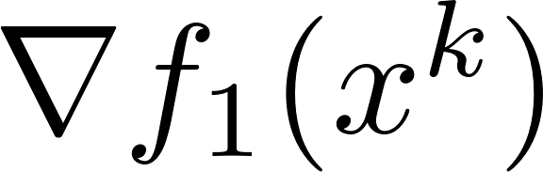
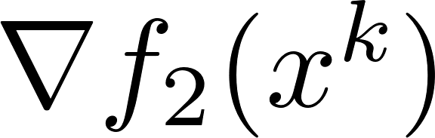
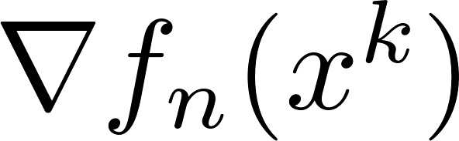
Distributed Gradient Descent
#10
. . .
. . .

Slide 17
Distributed Gradient Descent
#10
. . .
. . .

Slide 18
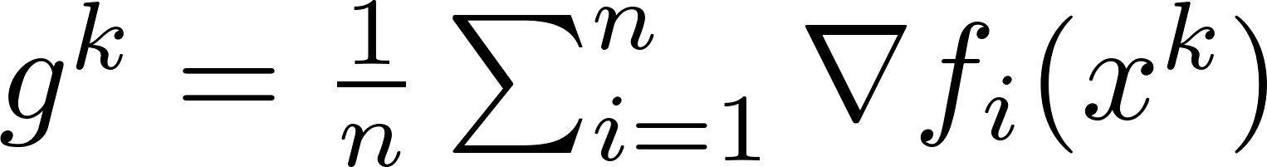
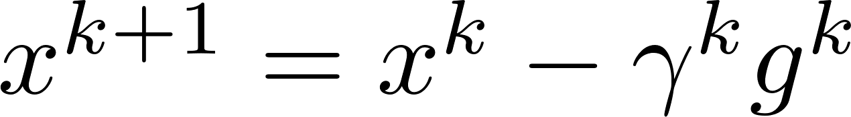
Distributed Gradient Descent
#10
. . .
. . .

Slide 19
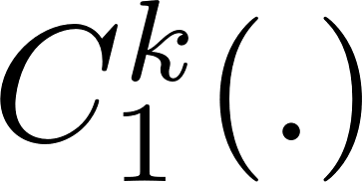
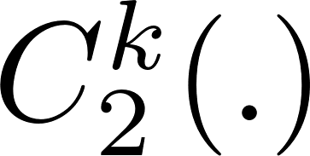
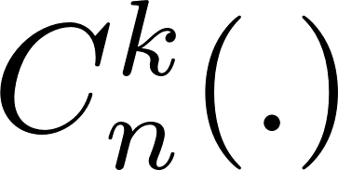
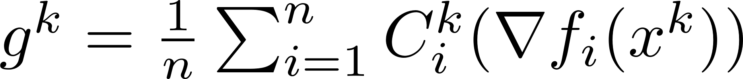
Distributed Compressed Gradient Descent
#11
COMPRESS
. . .
. . .

Slide 20
Compressors
#12
Cost Model

Slide 21

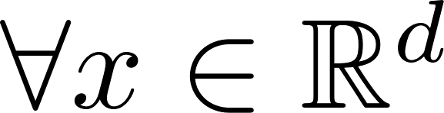
Compressors
#12
Cost Model
Class of Unbiased Compressors

Slide 22
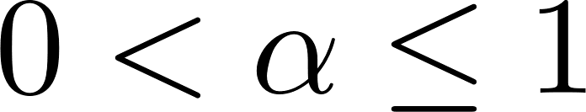
Compressors
#12
Cost Model
Class of Unbiased Compressors
Class of Contractive Compressors

Slide 23
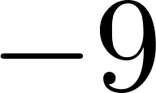
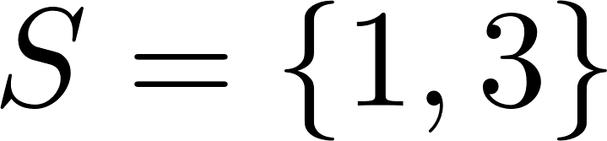


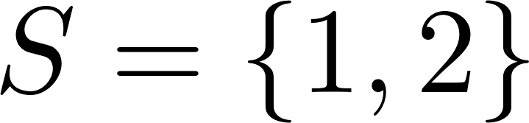
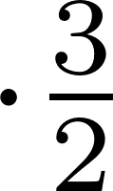
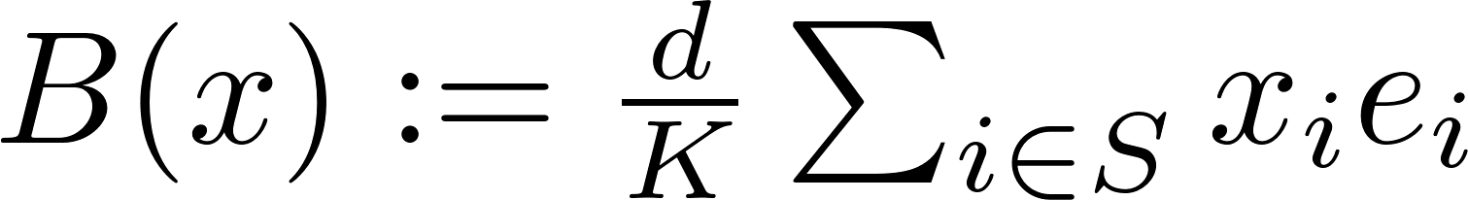

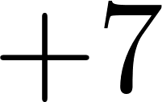
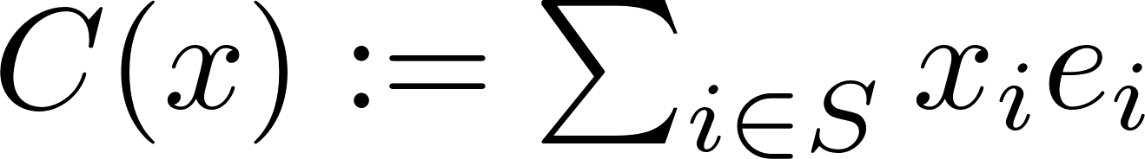

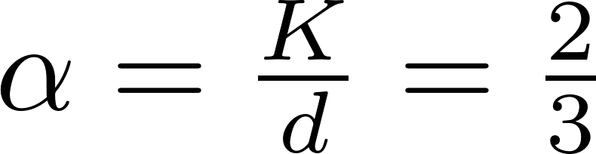
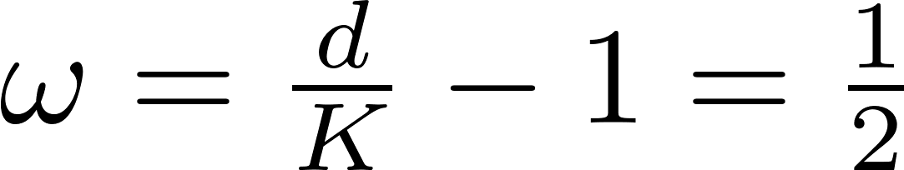
Compressors
#12
Cost Model
Class of Unbiased Compressors
Class of Contractive Compressors
Sparsification Examples $(d=3, K=2)$

Slide 24
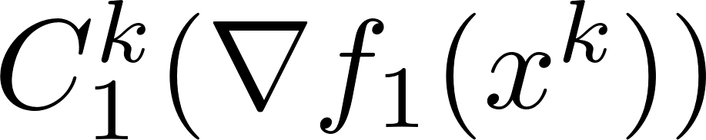
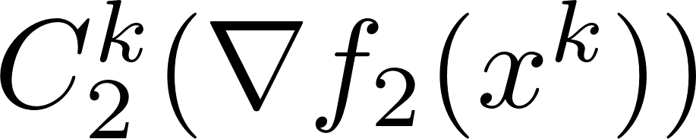
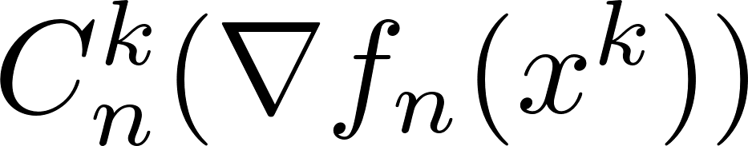
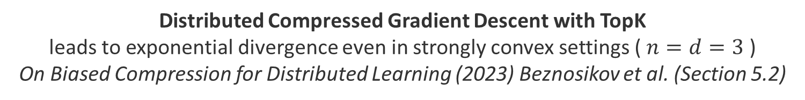
Distributed Compressed Gradient Descent
With Contractive Compressors
#13
. . .
Distributed Compressed Gradient Descent with TopK
leads to exponential divergence even in strongly convex settings ( $n=d=3$ )
On Biased Compression for Distributed Learning (2023) Beznosikov et al. (Section 5.2)

Slide 25
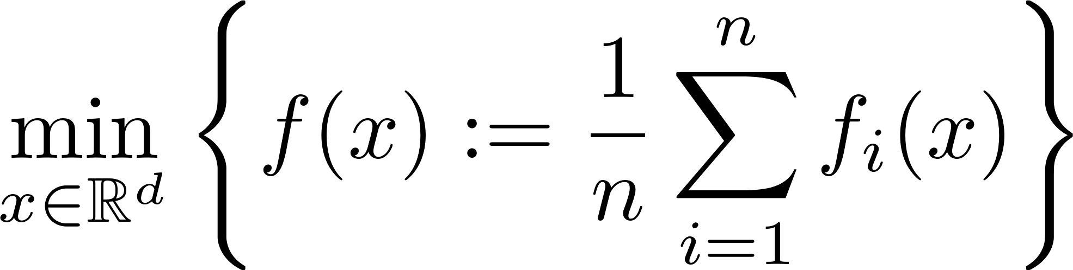
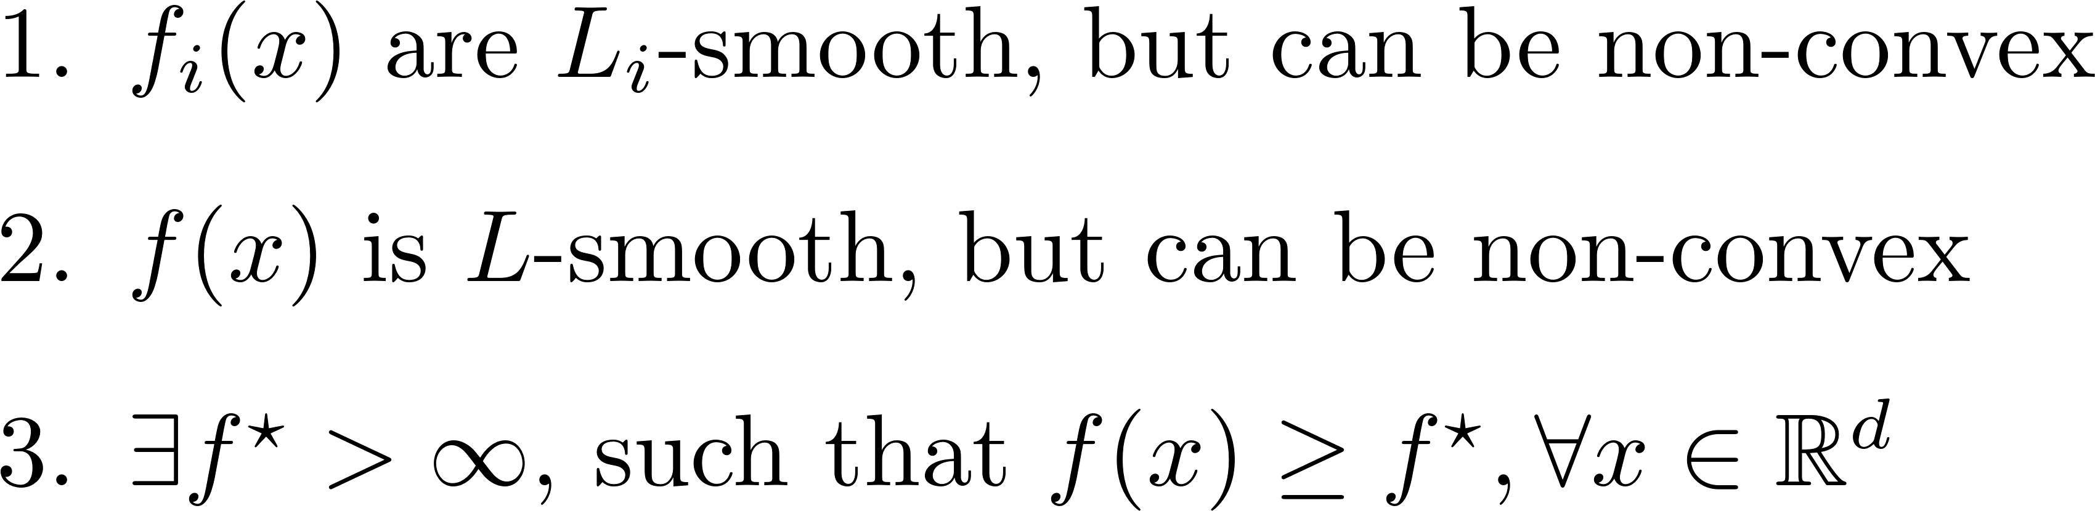
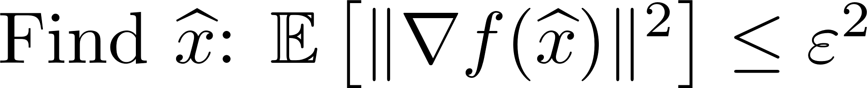
EF21
#14
EF21 (Richtárik et al., 2021) is the theoretically fastest method that is provably correct when using contractive compressors
Assumptions:
Goal:

Slide 26

EF21
#14
EF21 (Richtárik et al., 2021) is the theoretically fastest method that is provably correct when using contractive compressors
Assumptions:
Goal:

Slide 27

EF21
#15
At Client
At Master

Slide 28
EF21
#15
Total Number of Clients
Iteration
Client

Slide 29
EF21
#15
Communicated from
Master to Client
Communicated from
Client to Master

Slide 30

EF21
#15

Slide 31



EF21
#15
EF21 guarantees

Slide 32


EF21
#15
Total Iterations

Slide 33

EF21
#16

Slide 34

EF21
#16

Slide 35


EF21
#16

Slide 36

Ch3: EF21 Reloaded (2024)
#17

Slide 37














Example-Driven Reformulation
#18
QM changed, even AM is the same !
Notes:
C_i^t (\frac{1}{n w_i}\nabla f_i(x^{t+1}) - g_i^t)
Maybe decrease details
Supress beta/theta factor

Slide 38



Ch3: EF21 Reloaded (Approach 1)
#19

Slide 39

Ch3: EF21 Reloaded (Approach 1)
#19
. . .
...

Slide 40



Ch3: EF21 Reloaded (Approach 1)
#19
. . .
...
Notes:
C_i^t (\frac{1}{n w_i}\nabla f_i(x^{t+1}) - g_i^t)
Maybe decrease details
Supress beta/theta factor

Slide 41

Ch3: EF21 Reloaded (Approach 1)
#20
Notes:
C_i^t (\frac{1}{n w_i}\nabla f_i(x^{t+1}) - g_i^t)
Maybe decrease details
Supress beta/theta factor

Slide 42



Ch3: EF21 Reloaded (Approach 1)
#20
Notes:
C_i^t (\frac{1}{n w_i}\nabla f_i(x^{t+1}) - g_i^t)
Maybe decrease details
Supress beta/theta factor

Slide 43


Ch3: EF21 Reloaded (Approach 2)
#21
Good: We reduced QM to AM (up to the factor $\sqrt{2}$)
Bad: We need to increase number of workers $n→N,n≤N≤2n$
EF21-W
Notes:
C_i^t (\frac{1}{n w_i}\nabla f_i(x^{t+1}) - g_i^t)
Maybe decrease details
Supress beta/theta factor

Slide 44
Ch3: EF21 Reloaded (Approach 2)
#21
Good: We reduced QM to AM (up to the factor $\sqrt{2}$)
Bad: We need to increase number of workers $n→N,n≤N≤2n$
Assumptions: B1. Initial shifts​ for all clones are identical B2. The compressors are deterministic
⇒ Under these assumptions, the cloning mechanism can be reformulated as a new EF21-W
EF21-W
Notes:
C_i^t (\frac{1}{n w_i}\nabla f_i(x^{t+1}) - g_i^t)
Maybe decrease details
Supress beta/theta factor

Slide 45



Ch3: EF21 Reloaded (Approach 2)
#21
Good: We reduced QM to AM (up to the factor $\sqrt{2}$)
Bad: We need to increase number of workers $n→N,n≤N≤2n$
Assumptions: B1. Initial shifts​ for all clones are identical B2. The compressors are deterministic
⇒ Under these assumptions, the cloning mechanism can be reformulated as a new EF21-W
EF21-W
Notes:
C_i^t (\frac{1}{n w_i}\nabla f_i(x^{t+1}) - g_i^t)
Maybe decrease details
Supress beta/theta factor

Slide 46
Ch3: EF21 Reloaded (Approach 2)
#21
Good: We reduced QM to AM (up to the factor$\sqrt{2}$)
Bad: We need to increase number of workers $n→N,n≤N≤2n$
Assumptions: B1. Initial shifts for all clones are identical B2. The compressors are deterministic
⇒ Under these assumptions, the cloning mechanism can be reformulated as a new EF21-W
Our analysis reveals that assumptions (B1) and (B2) are not required
EF21-W
Notes:
C_i^t (\frac{1}{n w_i}\nabla f_i(x^{t+1}) - g_i^t)
Maybe decrease details
Supress beta/theta factor

Slide 47
Ch3: EF21 Reloaded (Approach 3)
#22
The analysis of EF21-W reveals that the original EF21 analysis requires modification for the quantity $G^{t}$
It motivated us to analyze the original EF21 and discover:
Incorporating weights into the original EF21 analysis improves the rate !!
Weights in EF21 Analysis
Notes:
C_i^t (\frac{1}{n w_i}\nabla f_i(x^{t+1}) - g_i^t)
Maybe decrease details
Supress beta/theta factor

Slide 48
Federated Learning Challenges Addressed in the Thesis
#23
Theoretical Work
Theory-Inspired Practical Work
Practical Work
1. Data Heterogeneity
2. Device Heterogeneity
3. Communication
Bottleneck
4. Privacy
5. Software
Ch1: Introduction
Ch2: FL_PyTorch
Burlachenko et al., 2021
Ch3: EF21-W
Richtárik et al., 2024
Ch3: EF21-W
Richtárik et al., 2024
Ch4: DCGD/PERMK/AES
Burlachenko et al., 2023
Ch5: PAGE Extensions
Tyurin et al., 2023
Ch6:
Compressed L2GD
Bergou et al., 2023
Ch6:
Compressed L2GD
Bergou et al., 2023
Ch7: Unlocking FedNL
Burlachenko and Richtárik, 2024
Ch7: Unlocking FedNL
Burlachenko & Richtárik, 2024
Ch8: BurTorch
Burlachenko & Richtárik, 2025
Ch8: BurTorch
Burlachenko & Richtárik, 2025
Ch9: Concluding Remarks: Summary and Future Research
Notes:
Color pallete
Color is non-obvious

Slide 49





Main Tools for Privacy Guarantees in FL
#24
Trusted Execution Environments (TEE)
Protects the execution environment from illegal intervention
Differential Privacy (DP)
Protects output of algorithm so that users’ data are not leaking after execution
Secure Multi-Party Computation (MPC)
Protects inputs of algorithm at the cost of communication
Homomorphic Encryption (HE)
Computation on encrypted data without revealing inputs or outputs

Slide 50
Homomorphic Encryption (HE)
#25
Homomorphic Encryption:
Computation on encrypted data without revealing inputs or outputs
Homomorphic Encryption In Action:
1. Any device with the public key can perform computations on encrypted data
2. Only the holder of the private key can decrypt the result
Cheon-Kim-Kim-Song (CKKS, 2017):
a. The CKKS scheme supports approximate arithmetics on real and complex dense vectors and is considered as SOTA in this class
b. CKKS (and HE in general) is more complex primitive than classical block ciphers (e.g. AES-based), relying on entirely different mathematical foundations

Slide 51




Distributed Compressed Gradient Descent with Homomorphic Encryption (HE)
#26
Average of Encrypted Messages =
Encryption of Average
of Plain Messages
. . .

Slide 52
Classical Cryptography: AES Block Cipher
#27
128 bits
128 bits
Encrypt
Decrypt
Plaintext Block
Ciphertext Block
Key
128|192|256 bits
AES (2001) Block Cipher
Maps deterministically and with reversible operations input (128 bits) into output (128 bits)
Has hardware support (Intel Westmere, AMD Bulldozer, ARM Cortex-A53)
AES is a strong cryptographic primitive, widely trusted as a secure PRP
A secure pseudorandom permutation (PRP)
produces permutations that are computationally indistinguishable from uniformly random permutations by any known polynomial-time algorithm

Slide 53

DP, HE, MPC, TEE…
But where is Classical Cryptography?
#28
Researchers from 2020 – 2024 consistently argue that applying symmetric-key
encryption like AES or DES in FL is
unsuitable, challenging, not feasible
Secure, Privacy-Preserving, and Federated Machine Learning in Medical Imaging,
G. Kaissis et al. (2020) Nature Machine Intelligence
Private Artificial Intelligence: Machine Learning on Encrypted Data,
Kristin E. Lauter (2022) SIAM
Cybersecurity English Accelerated Encrypted Execution of General Purpose Applications,
V. Joseph et al (2023) NVIDIA Blog
FedSHE: Privacy-Preserving and Efficient Federated Learning with Adaptive Segmented CKKS Homomorphic Encryption,
Pan Y. et al. (2024) Cybersecurity
Revisiting Fully Homomorphic Encryption Schemes for Privacy-Preserving Computing,
N. Jain et al. (2024) Emerging Technologies and Security in Cloud Computing

Slide 54






Ch4: DCGD/PermK/AES (2023)
#29
Distributed Compressed Gradient Descent
Permutated Correlated Compressors
Advanced Encryption Standard

Slide 55

DCGD/PermK
#30

Slide 56









DCGD/PermK
#30
PermK Compressors (Rafał Szlendak, et al. 2021)

Slide 57






DCGD/PermK
#30
0.1 | 1.1 | 2.1
0.2 | 1.2 | 2.2
0.3 | 1.3 | 2.3
0.4 | 1.4 | 2.4
-0.5 | 1.5 | 2.5
0.6 | 1.6 | 2.6
0.1
0.2
0
0
0
0
0
0
1.3
1.4
0
0
0
0
0
0
2.5
2.6
Training Iteration
Scaling is needed to preserve unbiasedness

Slide 58




DCGD/PermK
#30
Algebraic Properties of PermK

Slide 59



DCGD/PermK/AES
#30

Slide 60


DCGD/PermK/AES
#30

Slide 61
DCGD/PermK/AES
#30
HE/CKKS for AES-128 security level requires key(s) with sizes 420 000 bytes
For AES-128 the key size is 128 bits (16 bytes)

Slide 62


DCGD/PermK/AES vs HE
#31
NEW
− Only compatible with specific
+ Does not introduce numerical errors
+ Low memory overhead from AES
CLASSICAL HE
+ Works with arbitrarily
− Introduces numerical errors
− High memory overhead
Notes:
AES – permutaiton, Grover’s search process can be a bit dangerous for AES because search space is reduced to sqrt{N}
CKKS – use LWE. Oded Regev has obtained a Gödel prize in 2018 for it. Find s for As + e = b for u.a.r. A and u.a.r. e (but small) is hard. Secrets: s and “e”. B and A are public.

Slide 63

DCGD/Permk/AES vs DCGD/PermK vs GD vs GD/CKKS
#32

Slide 64




Semi-Asynchronous Behavior for DCGD/PermK
#33

Slide 65

Federated Learning Challenges Addressed in the Thesis
#34
Theoretical Work
Theory-Inspired Practical Work
Practical Work
1. Data Heterogeneity
2. Device Heterogeneity
3. Communication
Bottleneck
4. Privacy
5. Software
Ch1: Introduction
Ch2: FL_PyTorch
Burlachenko et al., 2021
Ch3: EF21-W
Richtárik et al., 2024
Ch3: EF21-W
Richtárik et al., 2024
Ch4: DCGD/PERMK/AES
Burlachenko et al., 2023
Ch5: PAGE Extensions
Tyurin et al., 2023
Ch6:
Compressed L2GD
Bergou et al., 2023
Ch6:
Compressed L2GD
Bergou et al., 2023
Ch7: Unlocking FedNL
Burlachenko and Richtárik, 2024
Ch7: Unlocking FedNL
Burlachenko & Richtárik, 2024
Ch8: BurTorch
Burlachenko & Richtárik, 2025
Ch8: BurTorch
Burlachenko & Richtárik, 2025
Ch9: Concluding Remarks: Summary and Future Research
Notes:
Color pallete
Color is non-obvious

Slide 66
Distributed Gradient Descent => Distributed Newton
#35

Slide 67





Distributed Gradient Descent => Distributed Newton
#35
Backtracking line search
[BV, 2004]

Slide 68
Distributed Gradient Descent => Distributed Newton
#35
Bad: The memory requirement for forming and storing second-order information

Slide 69


Distributed Gradient Descent => Distributed Newton
#35
Good: $Error^{k+1}≤Const⋅{\left(Error^{k}\right)}^{2}.$In practice, number of iterations is $≈6$.
Notes:
simplify

Slide 70


Federated Newton Learn (2022)
(Existing)
#36
#23
Problem
FedNL: Federated Newton Learn
(M. Safaryan et al., 2022)
EF21 Mechanism
FedNL Technicality
Generalizing Biased and Unbiased Compressors to Symmetric Matrices
Assumptions for FedNL Family
$f(x)$ is $μ$ strongly convex and $f_{i}(x)$ has Lipschitz continuous Hessian
Notes:
In face Polyak- Lojasiewicz inequality second bound is PL inequality on its own, but can be used to bound discrepancy in function value.

Slide 71




Federated Newton Learn (2022)
(Existing)
#36
#23
Problem
FedNL: Federated Newton Learn
(M. Safaryan et al., 2022)
FedNL Local Superlinear Convergence Guarantees
$D$ depend on Smoothness of Hessian
Notes:
In face Polyak- Lojasiewicz inequality second bound is PL inequality on its own, but can be used to bound discrepancy in function value.

Slide 72
Federated Newton Learn (2022)
(Existing)
#36
#23
Can we practically use the FedNL implementation presented at ICML 2022?
Notes:
In face Polyak- Lojasiewicz inequality second bound is PL inequality on its own, but can be used to bound discrepancy in function value.

Slide 73
Federated Newton Learn (2022)
(Existing)
#36
#23
Can we practically use the FedNL implementation presented at ICML 2022?
Not Yet!
Requires 4.8 hours to launch a single experiment on a server-grade workstation
The prototype supports only a multi-node simulation
Prototype integration into resource-constrained applications is challenging
Notes:
In face Polyak- Lojasiewicz inequality second bound is PL inequality on its own, but can be used to bound discrepancy in function value.

Slide 74
Problem is Deeper
#37
Fact #1 from Data-intensive Computing and OS
Overheads introduced from a large number of components lead to degradation
[1] Scalability! but at what COST?” by McSherry et.al., 2015
Fact #2 from Computer Architecture/Programming Languages
Scripting languages offer the advantage of democratizing implementations.
But their eco-system clashes too much with the principles of the real hardware.
[2] There’s plenty of room at the top: What will drive computer performance after
Moore’s law? by Leiserson et al., Science 2020
Fact #3 from S. Boyd: This is awesome! I want to use whatever you so-called Control. What should I use? …nothing.
[3] InControl podcast: Interview with Stephen Boyd, 2023, 01:17:10
Fact #4 from P. Liang: We are in a crisis. Researchers are disconnected from underlying technologies through abstractions. The problem is abstractions are leaky.
[4] P. Liang, Stanford CS336 Language Modeling from Scratch, Spring 2025

Slide 75
Ch7: Unlocking FedNL (2024) From Theory to Practice
#38
Simultaneously advancing a rigorous theoretical framework and an efficient implementation presents a significant challenge, as both are equally demanding
Contributions for Making FedNL Practical
We proposed two new practical compressors
Reduced wall clock time of a baseline by ×1000
Outperforms several best practice solutions
Complete independence on 3rd party frameworks
[Linux, Win, macOS] x [AArch64, x86-64, CUDA]
Can be utilized as native OS executable binaries and libraries

Slide 76

Pessimism of TopK Contraction Factor
#39

Slide 77


Adaptive TopLEK Compressor
#40
The idea is to perform compression using $TopK$, with smaller parameter
compressing as much as theoretically allowed — but no more
For $TopLEK$, the inequality that describes contraction becomes a tight equality

Slide 78
Cache-aware RanSeqK Compressor
#41
RandK selects a subset of coordinates of cardinality $k$ u.a.r. from a total of $d$ coordinates, zeroing out the rest and scaling the output to preserve unbiasedness

Slide 79

Cache-aware RanSeqK Compressor
#41
RanSeqK selects a pivot $s$ u.a.r. from $\left\{1,2,…,d\right\},$then selects deterministically a block of size $k$ from $(1,2,…,d)$seen as a torus
It has the same variance as RandK,
but it is more appealing in practice

Slide 80


Ch7: Unlocking FedNL
Single Node Experiments: L2 Regularized Logistic Regression
#42
Baseline Improvements
Single Node

Slide 81

Ch7: Unlocking FedNL
Multi Node Experiments: L2 Regularized Logistic Regression
#43

Slide 82
Ch7: Structure of x1000 Time Improvement for Single Node
FP64, 3.3Ghz, 12 cores, Intel(R) CPU. Logistic Regression d=301
#44
Baseline: Single node Python/NumPy implementation from the original paper
x1
Rewrite in pure C++20/CMake with support macOS, Linux, Windows
x20
Data Processing Optimization
x1.077
Eliminating Integer Division
x1.225
Utilizing AVX512 CPU Extension in x86-64
x1.379
Total number of improvements at a finer granularity: 62
Compiler and Linker Optimization
x1.128
Use Sparsity from FedNL Compressors
x1.44
Reuse Computation from Oracles
x1.50
Basic Linear Algebra Improvements
x1.338
Linear System Solve Improvement
x1.31
Custom oracles without using Cache-Oblivious matrix multiplication
x3.072
Better Compressors Implementation:
x1.14
Thread pool of workers equal to number of physical cores, atomics for sync
x1.412
Mem. Optimization. Custom client-specific memory pool instead of global
x1.278

Slide 83

Federated Learning Challenges Addressed in the Thesis
#45
Theoretical Work
Theory-Inspired Practical Work
Practical Work
1. Data Heterogeneity
2. Device Heterogeneity
3. Communication
Bottleneck
4. Privacy
5. Software
Ch1: Introduction
Ch2: FL_PyTorch
Burlachenko et al., 2021
Ch3: EF21-W
Richtárik et al., 2024
Ch3: EF21-W
Richtárik et al., 2024
Ch4: DCGD/PERMK/AES
Burlachenko et al., 2023
Ch5: PAGE Extensions
Tyurin et al., 2023
Ch6:
Compressed L2GD
Bergou et al., 2023
Ch6:
Compressed L2GD
Bergou et al., 2023
Ch7: Unlocking FedNL
Burlachenko and Richtárik, 2024
Ch7: Unlocking FedNL
Burlachenko & Richtárik, 2024
Ch8: BurTorch
Burlachenko & Richtárik, 2025
Ch8: BurTorch
Burlachenko & Richtárik, 2025
Ch9: Concluding Remarks: Summary and Future Research
Notes:
Color pallete
Color is non-obvious

Slide 84
Federated Learning Challenges Addressed in the Thesis
#45
Theoretical Work
Theory-Inspired Practical Work
Practical Work
1. Data Heterogeneity
2. Device Heterogeneity
3. Communication
Bottleneck
4. Privacy
5. Software
Ch1: Introduction
Ch2: FL_PyTorch
Burlachenko et al., 2021
Ch3: EF21-W
Richtárik et al., 2024
Ch3: EF21-W
Richtárik et al., 2024
Ch4: DCGD/PERMK/AES
Burlachenko et al., 2023
Ch5: PAGE Extensions
Tyurin et al., 2023
Ch6:
Compressed L2GD
Bergou et al., 2023
Ch6:
Compressed L2GD
Bergou et al., 2023
Ch7: Unlocking FedNL
Burlachenko and Richtárik, 2024
Ch7: Unlocking FedNL
Burlachenko & Richtárik, 2024
Ch8: BurTorch
Burlachenko & Richtárik, 2025
Ch8: BurTorch
Burlachenko & Richtárik, 2025
Ch9: Concluding Remarks: Summary and Future Research
Notes:
Color pallete
Color is non-obvious

Slide 85


Chapters Excluded from In-Depth Presentation
#46
Ch2: FL_Pytorch (2021) Existing software frameworks for FL prioritize deployment, raise the entry barrier, and demand expertise in distributed systems. Research requires tools with functionalities distinct from industrial runtimes.
Ch5: PAGE Extensions (2023) PAGE is a theoretical optimal algorithm for finding a stationary point in sampled gradient complexity in big - $𝒪$ notation. This work enhances the analysis of PAGE and extends it with other sampling strategies.
Ch6: Compressed L2GD (2023) New Paradigm for FL was proposed in “Federated Learning of a Mixture of Global and Local Models” (2021) by F.Hanzely and P.Richtárik. This work extends it with bidirectional communication compressors.
Ch8: BurTorch (2025) Latency-efficient backpropagation CPU implementation, which outperforms: JAX, TF, TF Lite, LibTorch (C++), PyTorch TorchScript, PyTorch Python, Apple MLX, Autograd, Micrograd in memory, time, consumed energy.
Notes:
Alg. Pseudocode
Fonts
Fotoes
Remove

Slide 86

#47
Thank You for Your Time and Attention!
All presented projects are accompanied by open-source code,
promoting a culture of openness and collaboration

Slide 87
Backup Slides

Slide 88




Ch2: FL_Pytorch
#48
FeLebrities (2023):
A User-Centric Assessment of Federated Learning Frameworks
W. Riviera,
I.B. Galazzo,
G. Menegaz
o
Notes:
Alg. Pseudocode
Fonts
Fotoes
Remove

Slide 89




Ch5: PAGE Extensions
#49
Key Step in Discovery Path
Theoretical Improvements
$L_{±,w}≤L_{+}$ and $L_{+,w}≤L_{+}$
$$\text{Comparison} \text{on} \text{synthetized} \text{quadratic}\text{s}$$
Notes:
\documentclass{article}
\usepackage{amsmath}
\usepackage{amssymb}
\pagestyle{empty}
\begin{document}
The \(\Omega \) is the probability sample space. Let \( S : a_1 \times \cdots \times a_n \cdots \Omega \xrightarrow{} m \) with the following properties:
\begin{enumerate}
\item $\mathbb{E}_w[S(\cdot)] = \frac{1}{n} \sum_{i=1}^n a_i$
\item $
\mathbb{E}_w \left[ \| S(\cdot) - \frac{1}{n} \sum_{i=1}^n a_i \|^2 \right] = \frac{A}{n} \sum_{i=1}^n \left( \frac{1}{n w_i} \|a_i\|^2 \right) - B \| \frac{1}{n} \sum_{i=1}^n a_i \|^2
$
\end{enumerate}
In the paper, we provide several sampling strategies that satisfy the above conditions. The sampling algorithm determines the parameters: \( A \), \( B \), and \( w_i \).
Next, with respect to the weighting \( w_i \), we require to estimate the constants \( L_{+,w} \) and \( L_{\pm,w} \):
\begin{enumerate}
\item $
\frac{1}{n} \sum_{i=1}^n \frac{1}{n w_i} \| \nabla f_i(x) - \nabla f_i(y) \|^2 \leq L_{+,w}^2 \|x - y\|^2
$
\item $
\frac{1}{n} \sum_{i=1}^n \frac{1}{n w_i} \left( \| \nabla f_i(x) - \nabla f_i(y) \|^2 - \| \nabla f(x) - \nabla f(y) \|^2 \right) \leq L_{\pm,w}^2 \|x - y\|^2
$
\end{enumerate}
\end{document}
%======================================
\documentclass{article}
\usepackage{amsmath}
\usepackage{amssymb}
\pagestyle{empty}
\begin{document}
Our Theory for Single Gradient Oracles:
\[
N = \mathcal{O}\left( n + \frac{\Delta_0}{\epsilon^2} \cdot |S| \left( L_{-} + \sqrt{\frac{n}{|S|} ( (A - B) L_{+,w}^2 + B L_{\pm,w}^2) } \right) \right)
\]
Original PAGE Analysis:
\[
N_{\text{orig}} = \mathcal{O} \left( n + \frac{\Delta_0}{\epsilon^2} \cdot \left( L_{-} + \sqrt{n} L_{+} \right) \right)
\]
Improved Original PAGE Analysis:
\[
N_{\text{improved}} = \mathcal{O} \left( n + \frac{\Delta_0}{\epsilon^2} \cdot \left( 0 + \sqrt{n} L_{+} \right) \right)
\]
Important Sampling in PAGE:
\[
N_{\text{important-sampling}} = \mathcal{O} \left( n + \frac{\Delta_0}{\epsilon^2} \cdot \tau \cdot \left( L_{-} + \sqrt{\frac{n}{\tau}} L_{\pm,w} \right) \right)
\]
\end{document}

Slide 90









Ch6: Compressed L2GD
#50
Goals
Strongly convex case
Non-convex case
Compressors
Each client and master use its own unbiased compressor from $ℬ^{d}\left(w\right)$
Aspects of L2GD
$λ$ is scalar parameter which allows tradeoff between local and global model
$λ→0$ ($λ→+∞$) all nodes are working in decoupled (coupled) form
$p$ is probability of making (relaxed) aggregation
$1−p$ is a probability to make in parallel local GD steps
Results
The work extends paper [HR, 2021] with bidirectional unbiased compressors
Linear convergence rate to neighborhood (strongly convex case) and theory for non-convex case
Optimal values of $p(λ, L≔nL_{f})$
Extended empirical study
Highlighted that FedAVG is a particular case of L2GD when$ηλ≈np$

Slide 91




Ch8: BurTorch
Benchmarks Across Linux, macOS, and Windows
#51

Slide 92
Single-Node | Typical Bandwith
CPU <-> System DDR Memory | 51 200 MBytes/sec (DDR5)
GPU core <-> GPU DDR Memory | 128 000 MBytes/sec (GDDR6) DRAM in NVIDIA GPU NVIDIA Ada Lovelace 1008 000 MBytes/sec
GPU DDR <-> PCI-E <-> System DDR Memory | 4 000 MBytes / sec (PCI-E v5, 1 lane)
SATA 3x (HDD) | 6000 Mbytes / sec
USB 3.0 (External storage) | 600 MBytes / sec
GPU <-> GPU (NVLink) | 50 000 Mbytes/sec
GPU <-> GPU (NVLink via NVSwitch inside DGX-2) | 50 000 Mbytes/sec
#52
Multi-Node | Typical Bandwith
Fast Ethernet | 12.5 MBytes/sec
Gigabit Ethernet | 125 MBytes/sec
InfiniBand HDR | 6250 Mbytes/sec
InfiniBand Melanox | 25 000 Mbytes/sec

Slide 93



Ch4: AES and its Friends
#53
AES is secure for encoding a single block
For multiple blocks, it should be used with a
Mode of Operation Algorithm
Overhead: 16 bytes/message
Incorrect Electronic Code Book (ECB)
AES with EAX Authentication
Images: Google Search
Overhead: 16 bytes/message
To ensure that message has not been altered in transit,
AES should be paired with a
Message Authentication Code Algorithm
(Similar to CRC for non-secure applications)

Slide 94

Ch4: A Day of Life for Message with CKKS Scheme
#54

Slide 95

Ch4: A Day of Life for Message with CKKS Scheme
#54

Slide 96
Ch4: A Day of Life for Message with CKKS Scheme
#54

Slide 97
Ch4: A Day of Life for Message with CKKS Scheme
#54

Slide 99

Ch3: EF21 Reloaded
#55

Slide 100
Ch3: EF21 Reloaded
#55

Slide 101









Ch3: EF21 Reloaded (Approach 1)
#55
…
…

Slide 102

#54
Algorithm/Setting | Terminate condition | Iterations
Gradient Descent / $f(x)$ is strongly convex. (generalizable via adding regulizers with cheap proximal operator) | $${\left|x^{k}−x^{∗}\right|}^{2}≤ε{\left|x^{0}−x^{∗}\right|}^{2}$$ => if $∇f\left(x^{∗}\right)=0 then \left|f\left(x^{k}\right)−f\left(x^{∗}\right)\right|≤\frac{L}{2}{\left|x^{k}−x^{∗}\right|}^{2}$ | $$k≥\frac{L}{μ}\log\left(\frac{1}{ε}\right)$$
Stochastic Gradient Descent / $f(x)$ is strongly convex / $g(x)$ such that $E\left[g\left(x\right) | x\right]=∇f(x)$ / $g(x)$ such that $E\left[{\left|g\left(x\right)−∇f\left(x^{∗}\right)\right|}^{2} | x\right]≤2AD_{f}\left(x,x^{∗}\right)+C$ $D_{f}\left(x,x^{∗}\right)=f\left(x\right)−f\left(x^{∗}\right)−<∇f\left(x^{∗}\right),x−x^{∗}>$ | ${E[\left|x^{k}−x^{∗}\right|}^{2}]≤ε{\left|x^{0}−x^{∗}\right|}^{2}$ => if $∇f\left(x^{∗}\right)=0 then \left|f\left(x^{k}\right)−f\left(x^{∗}\right)\right|≤\frac{L}{2}{\left|x^{k}−x^{∗}\right|}^{2}$ | $$k≥O\left(\frac{1}{ε}⋅\log\left(\frac{1}{ε}\right)\right)$$
Gradient Descent / $f(x)$ is convex. | ${f(x}^{k})−f\left(x^{∗}\right)≤ε{\left|x^{0}−x^{∗}\right|}^{2}$ | $k≥\frac{1}{2αε}$ , $α∈\left(0, \frac{1}{L}\right]$
Accelerate Gradient Descent / $f(x)$ is convex. | ${f(x}^{k})−f\left(x^{∗}\right)≤ε{\left|x^{0}−x^{∗}\right|}^{2}$ | $k≥1+\sqrt{\frac{2}{αε}}$ , $α=\frac{1}{L}$ (Optimal)
Stochastic Subgradient Descent / $f(x)$ is convex / $g(x)$ is unbiased / easy prove: g(x) is bounded by G, start iterate $x^{0}$ has an upper bound distance R to $x^{∗}$ | $E[{f(x}^{k})−f\left(x^{∗}\right)]≤ε$ | $k≥O\left(\frac{1}{ε^{2}}\right)$ with optimal $a_{k}=\frac{R/G}{\sqrt{k}}$ (Optimal)
Stochastic Gradient Descent / $f(x)$ is convex / $g(x)$ is unbiased / g(x) satisfy sigma-k assumption | $E[{f(x}^{k})−f\left(x^{∗}\right)]≤ε$ | $k≥O\left(\frac{1}{ε}\right)$ to neighborhood. $k≥O\left(\frac{1}{ε^{2}}\right)$ exactly convergence to a solution. (Optimal)
Gradient Descent / $f(x)$ is non-convex, but smooth | $\left|∇{f(x}^{k}\right)|≤ε$ | $k≥O\left(\frac{1}{ε^{2}}\right)$
Stochastic Gradient Descent / $f(x)$ is non-convex, but smooth. | $E\left|∇{f(x}^{k}\right)|≤ε$ | From $k≥O\left(\frac{1}{ε^{2}}\right)$ to $k≥O\left(\frac{1}{ε^{4}}\right)$ depending on assumptions
Optimal SGD for case when $f(x)$ is finite sum of n functions / $f(x)$ is non-convex, but smooth (e.g. PAGE) PAGE reduces to GD if p=1 or $τ=n$ | $\left|∇{f(x}^{k}\right)|≤ε$ | $k≥O\left(\frac{\sqrt{n}}{ε^{2}}\right)$ (Optimal)

